Slide 1


Calculus and applications
MTH10012
Week 6

Slide 2
Introduction
Week 5
(Sequences) Sandwich theorem and relationship with continuous functions
Derivative definition, standard derivatives and rule of differentiation
Week 6
MODULE 4
The derivative of the inverse function, including trigonometric and hyperbolic functions
Implicit functions and their differentiation
Higher order derivatives, stationary points and optimisation
L’Hopital rule for indefinite forms

Slide 3
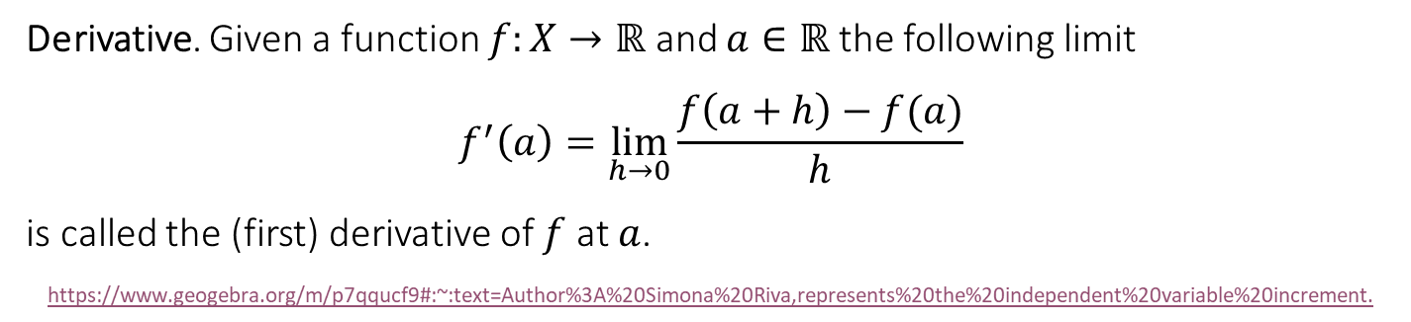
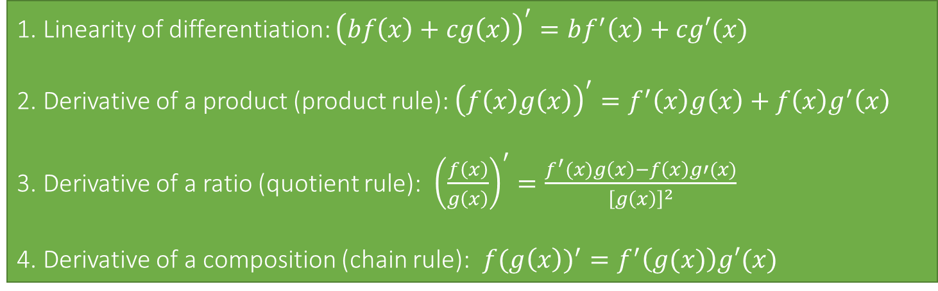
Recap
Derivative. Given a function $f:X→ℝ$ and $a∈ℝ$ the following limit
$$f^{′}\left(a\right)=\lim_{h→0}{\frac{f\left(a+h\right)−f(a)}{h}}$$
is called the (first) derivative of $f$ at $a$.
https://www.geogebra.org/m/p7qqucf9#:~:text=Author%3A%20Simona%20Riva,represents%20the%20independent%20variable%20increment.
1. Linearity of differentiation: ${\left(bf\left(x\right)+cg\left(x\right)\right)}^{′}=bf^{′}\left(x\right)+cg′(x)$
2. Derivative of a product (product rule): ${\left(f\left(x\right)g\left(x\right)\right)}^{′}=f^{′}\left(x\right)g\left(x\right)+f\left(x\right)g^{′}\left(x\right)$
3. Derivative of a ratio (quotient rule): ${\left(\frac{f\left(x\right)}{g\left(x\right)}\right)}^{′}=\frac{f^{′}(x)g\left(x\right)−f\left(x\right)g′(x)}{{\left[g\left(x\right)\right]}^{2}}$
4. Derivative of a composition (chain rule): ${f(g\left(x\right))}^{′}=f^{′}\left(g(x)\right)g′(x)$

Slide 4
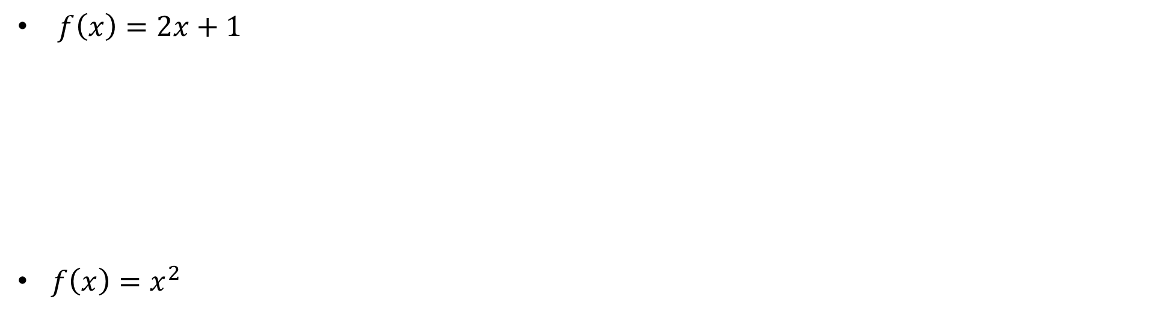
4.4 The derivative of the inverse function
$f\left(x\right)=2x+1$
$f\left(x\right)=x^{2}$

Slide 5
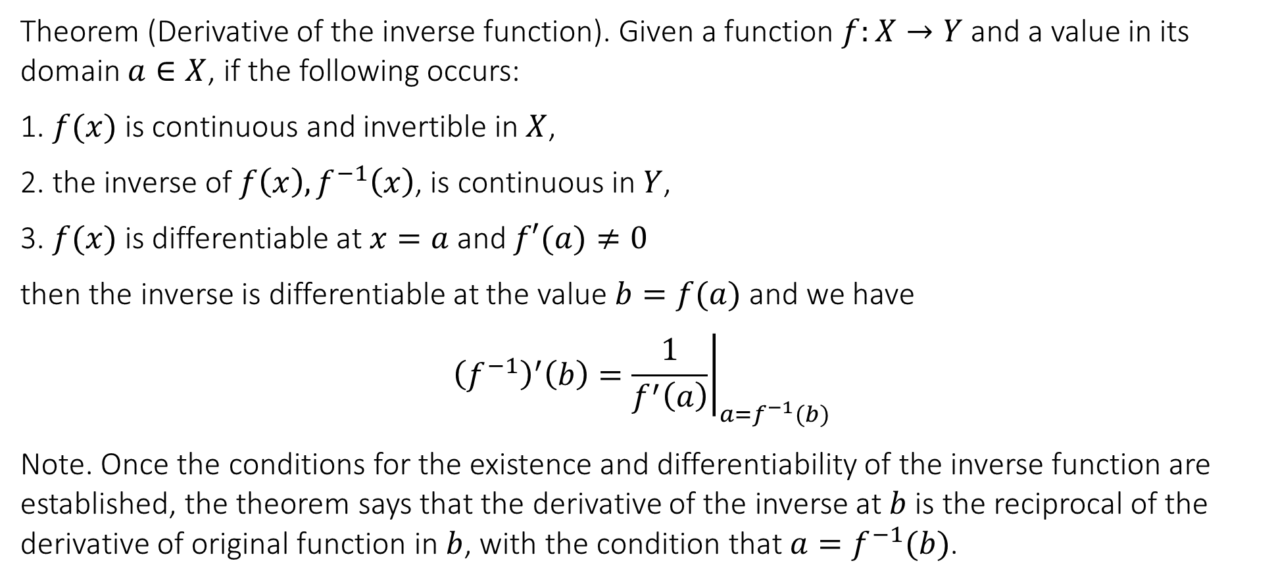
4.4 The derivative of the inverse function
Theorem (Derivative of the inverse function). Given a function $f:X→Y$ and a value in its domain $a∈X$, if the following occurs:
1. $f(x)$ is continuous and invertible in $X$,
2. the inverse of $f\left(x\right), f^{−1}\left(x\right)$, is continuous in $Y$,
3. $f(x)$ is differentiable at $x=a$ and $f′(a)≠0$
then the inverse is differentiable at the value $b=f(a)$ and we have
$${\left.{\left(f^{−1}\right)}^{′}\left(b\right)=\frac{1}{f^{′}\left(a\right)}\right|}_{a=f^{−1}(b)}$$
Note. Once the conditions for the existence and differentiability of the inverse function are established, the theorem says that the derivative of the inverse at $b$ is the reciprocal of the derivative of original function in $b$, with the condition that $a=f^{−1}(b)$.

Slide 6
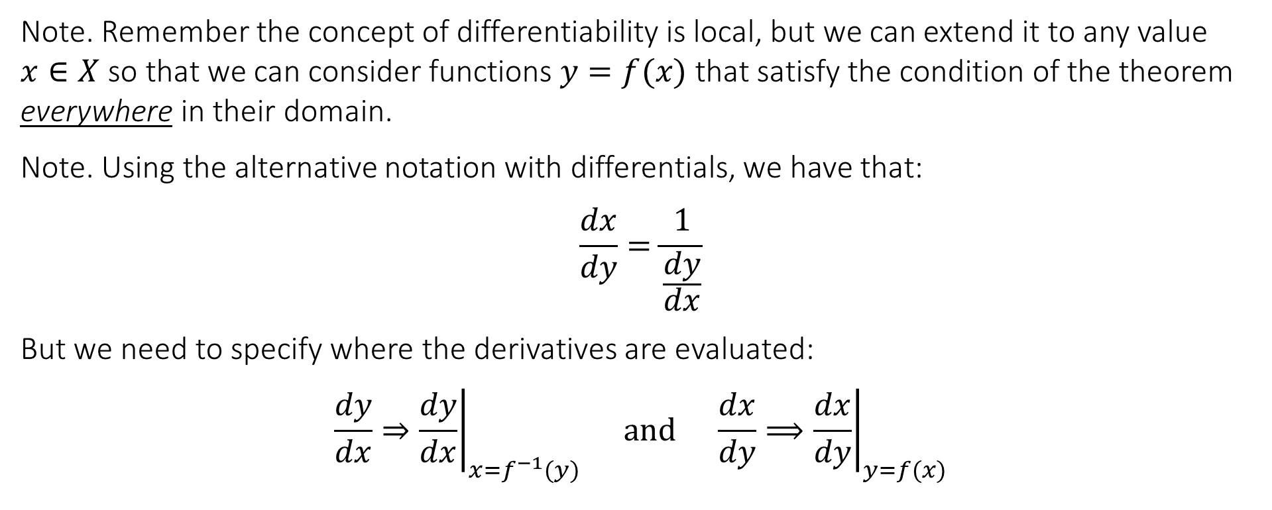
4.4 The derivative of the inverse function
Note. Remember the concept of differentiability is local, but we can extend it to any value $x∈X$ so that we can consider functions $y=f(x)$ that satisfy the condition of the theorem everywhere in their domain.
Note. Using the alternative notation with differentials, we have that:
$$\frac{dx}{dy}=\frac{1}{\frac{dy}{dx}}$$
But we need to specify where the derivatives are evaluated:
$$\frac{dy}{dx}⇒{\left.\frac{dy}{dx}\right|}_{x=f^{−1}(y)} and \frac{dx}{dy}⟹{\left.\frac{dx}{dy}\right|}_{y=f(x)}$$

Slide 7
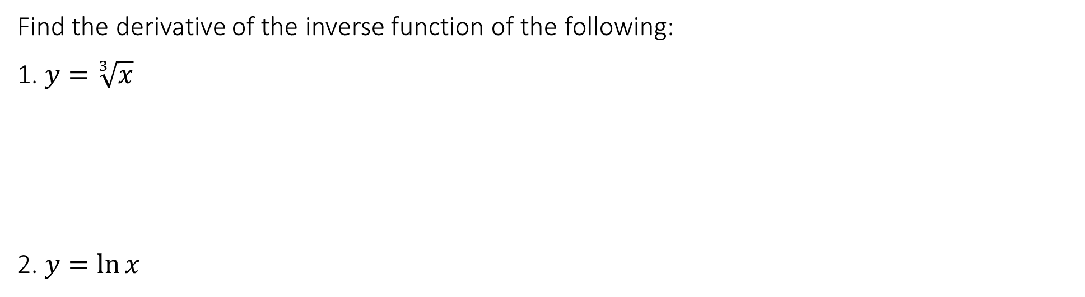
4.4 The derivative of the inverse function
Find the derivative of the inverse function of the following:
1. $y=\sqrt[3]{x}$
2. $y=\ln{x}$

Slide 8
4.4 The derivative of the inverse function
Derivatives of the inverse trigonometric and hyperbolic functions
Find $\frac{dy}{dx}$ given $y=\arcsin{x}$

Slide 9
4.4 The derivative of the inverse function
Find $\frac{dy}{dx}$ given $y=\operatorname{arcsinh}{x}$

Slide 10
4.4 The derivative of the inverse function
Derivatives of standard inverse trigonometric and hyperbolic functions (radians are assumed).

Slide 11
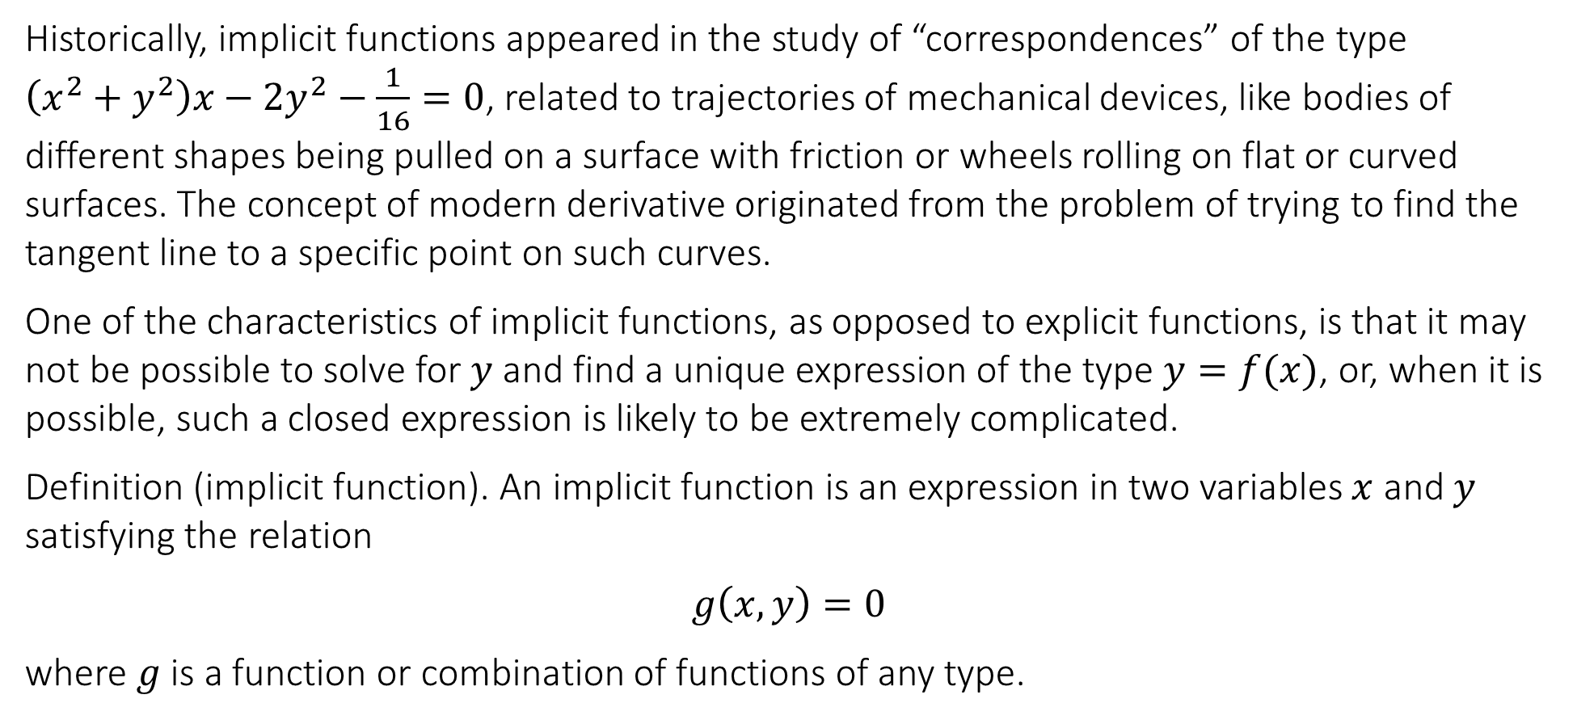
4.5 Implicit functions and their differentiation
Historically, implicit functions appeared in the study of “correspondences” of the type $\left(x^{2}+y^{2}\right)x−2y^{2}−\frac{1}{16}=0$, related to trajectories of mechanical devices, like bodies of different shapes being pulled on a surface with friction or wheels rolling on flat or curved surfaces. The concept of modern derivative originated from the problem of trying to find the tangent line to a specific point on such curves.
One of the characteristics of implicit functions, as opposed to explicit functions, is that it may not be possible to solve for $y$ and find a unique expression of the type $y=f(x)$, or, when it is possible, such a closed expression is likely to be extremely complicated.
Definition (implicit function). An implicit function is an expression in two variables $x$ and $y$ satisfying the relation
$$g\left(x,y\right)=0$$
where $g$ is a function or combination of functions of any type.

Slide 12
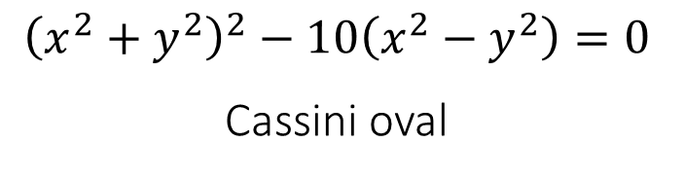
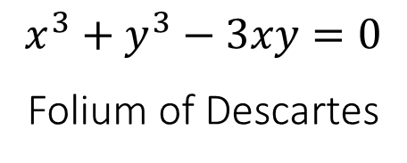
4.5 Implicit functions and their differentiation
$$x^{3}+y^{3}−3xy=0$$
Folium of Descartes
$${\left(x^{2}+y^{2}\right)}^{2}−10\left(x^{2}−y^{2}\right)=0$$
Cassini oval

Slide 13
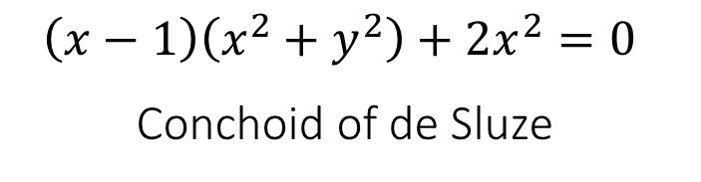
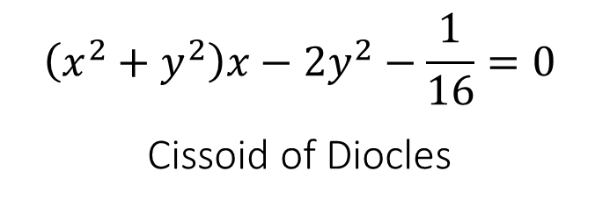
4.5 Implicit functions and their differentiation
$$\left(x^{2}+y^{2}\right)x−2y^{2}−\frac{1}{16}=0$$
Cissoid of Diocles
$$\left(x−1\right)\left(x^{2}+y^{2}\right)+2x^{2}=0$$
Conchoid of de Sluze

Slide 14
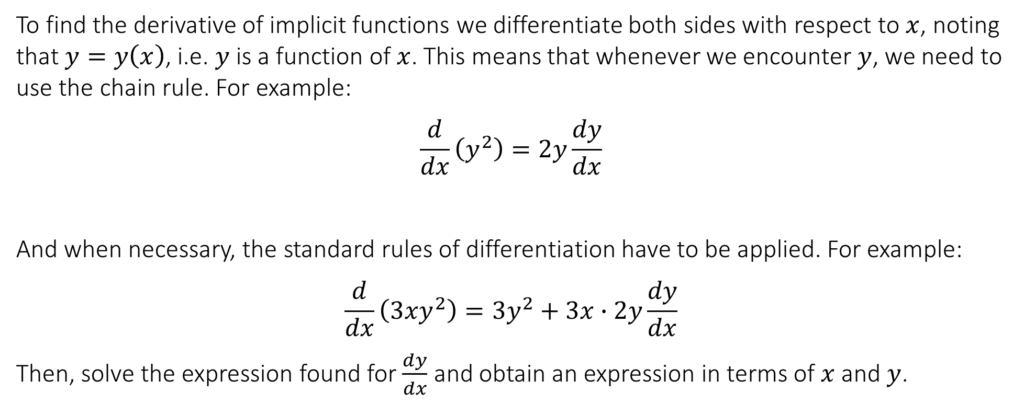
4.5 Implicit functions and their differentiation
To find the derivative of implicit functions we differentiate both sides with respect to $x$, noting that $y=y\left(x\right)$, i.e. $y$is a function of $x$. This means that whenever we encounter $y$, we need to use the chain rule. For example:
$$\frac{d}{dx}\left(y^{2}\right)=2y\frac{dy}{dx}$$
And when necessary, the standard rules of differentiation have to be applied. For example:
$$\frac{d}{dx}\left(3xy^{2}\right)={3y}^{2}+3x∙2y\frac{dy}{dx}$$
Then, solve the expression found for $\frac{dy}{dx}$ and obtain an expression in terms of $x$ and $y$.

Slide 15
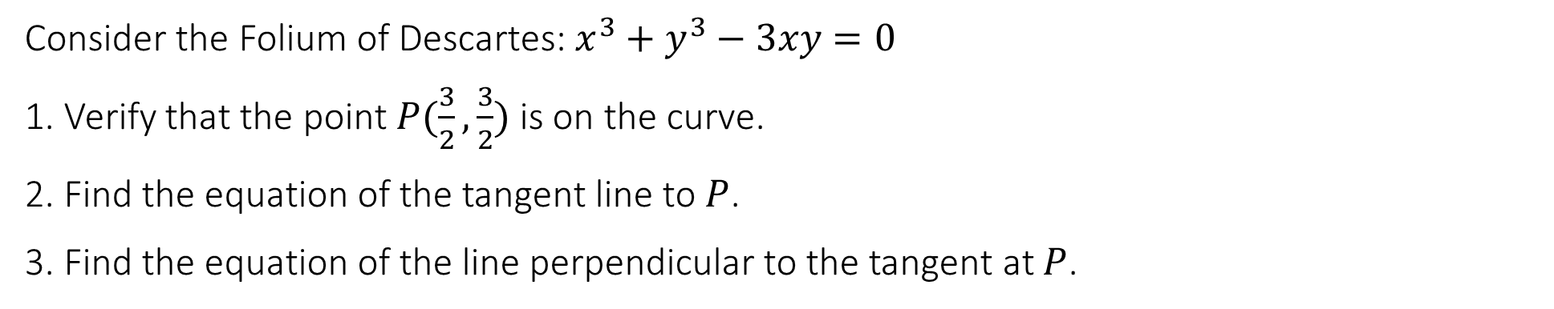
4.5 Implicit functions and their differentiation
Consider the Folium of Descartes: $x^{3}+y^{3}−3xy=0$
1. Verify that the point $P(\frac{3}{2},\frac{3}{2})$ is on the curve.
2. Find the equation of the tangent line to $P$.
3. Find the equation of the line perpendicular to the tangent at $P$.

Slide 16
4.5 Implicit functions and their differentiation
Find the derivative $\frac{dy}{dx}$ given the relation $xe^{y}=cos⁡(xy)$

Slide 17
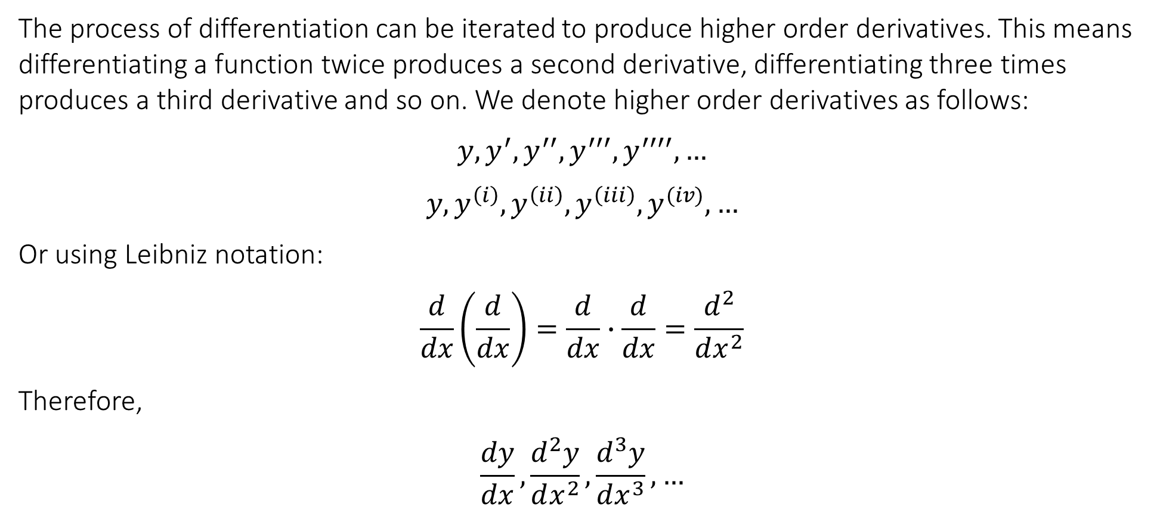
4.6 Higher order derivatives, stationary points and optimisation
The process of differentiation can be iterated to produce higher order derivatives. This means differentiating a function twice produces a second derivative, differentiating three times produces a third derivative and so on. We denote higher order derivatives as follows:
$$y,y^{′},y^{′′},y^{′′′},y^{′′′′},…$$
$$y,y^{\left(i\right)},y^{\left(ii\right)},y^{\left(iii\right)},y^{(iv)},…$$
Or using Leibniz notation:
$$\frac{d}{dx}\left(\frac{d}{dx}\right)=\frac{d}{dx}∙\frac{d}{dx}=\frac{d^{2}}{dx^{2}}$$
Therefore,
$$\frac{dy}{dx},\frac{d^{2}y}{dx^{2}},\frac{d^{3}y}{dx^{3}},…$$

Slide 18
4.6 Higher order derivatives, stationary points and optimisation
Given $y=\cos{2x}−3\sin{2x}$, calculate the first three derivatives.

Slide 19
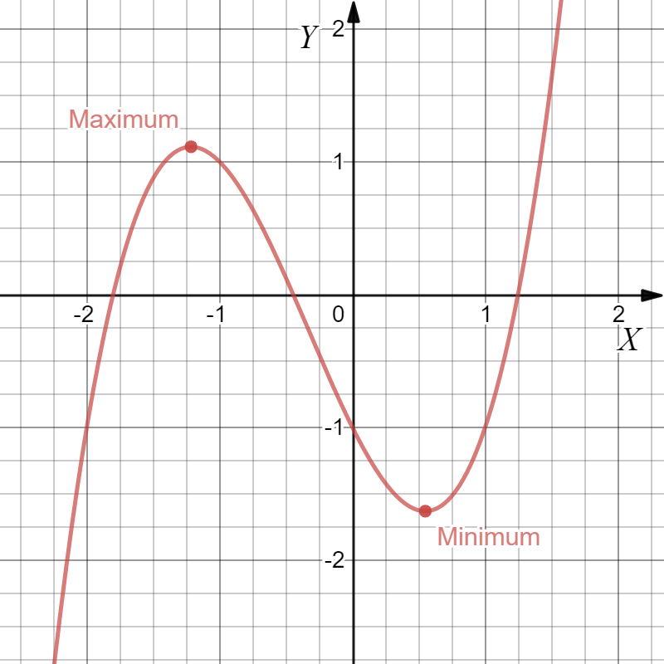




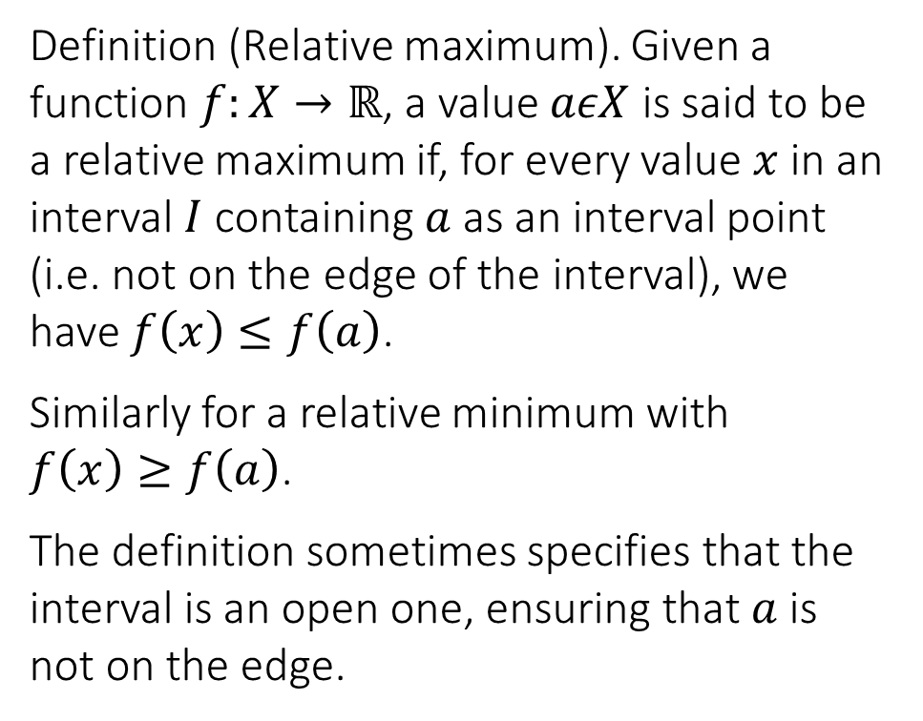








4.6 Higher order derivatives, stationary points and optimisation
Definition (Relative maximum). Given a function $f:X→ℝ$, a value $aεX$ is said to be a relative maximum if, for every value $x$ in an interval $I$ containing $a$ as an interval point (i.e. not on the edge of the interval), we have $f\left(x\right)≤f\left(a\right)$.
Similarly for a relative minimum with $f\left(x\right)≥f\left(a\right)$.
The definition sometimes specifies that the interval is an open one, ensuring that $a$ is not on the edge.
$$f(a)$$
$$f(x_{1})$$
$$f(x_{2})$$
$$x_{3}$$
$$b$$
$$x_{4}$$
[
]
[
]
$$x_{1}$$
$$a$$
$$x_{2}$$
$$f(x_{4})$$
$$f(x_{3})$$
$$f(b)$$

Slide 20
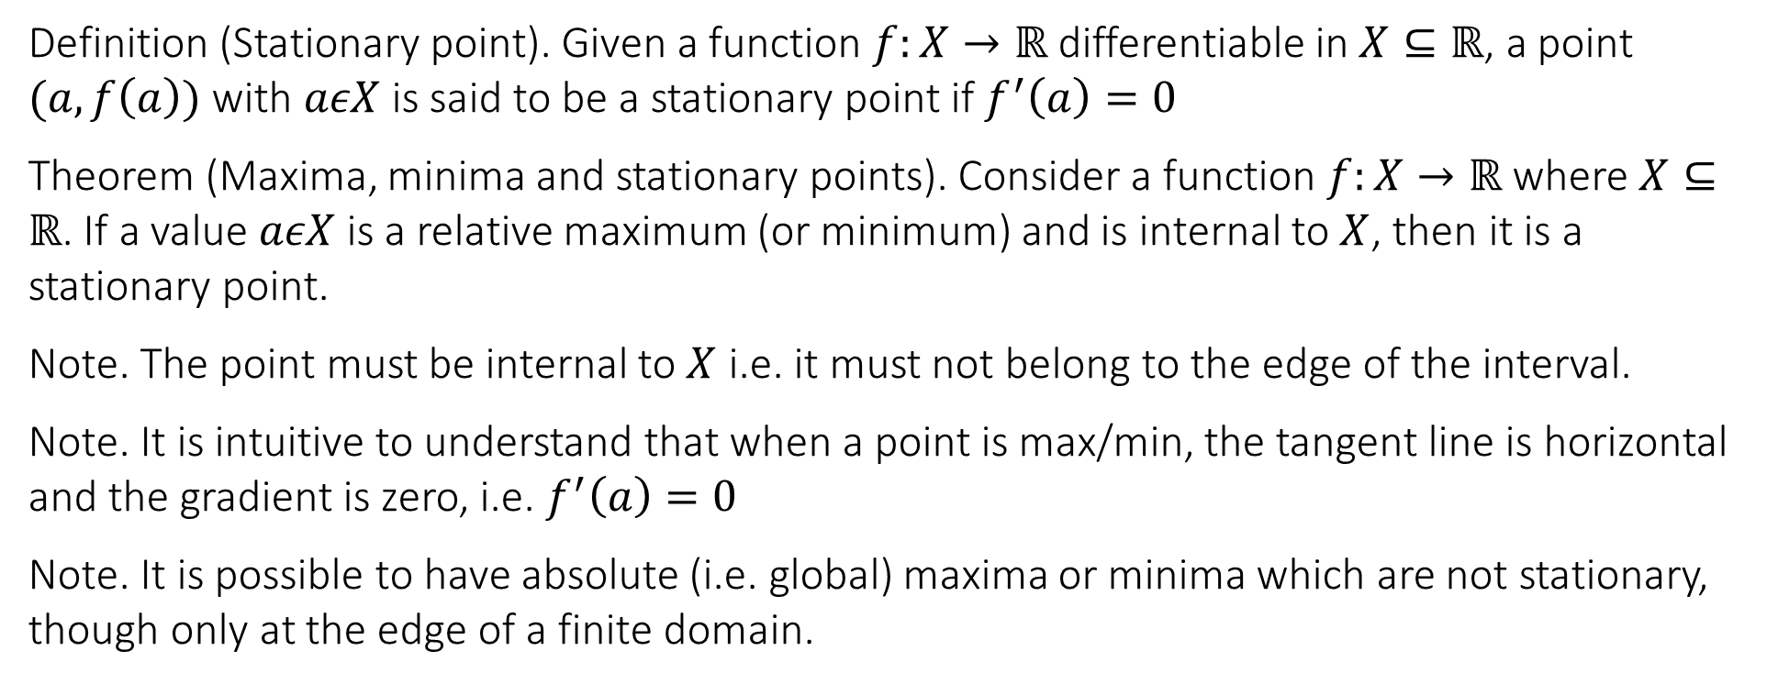
4.6 Higher order derivatives, stationary points and optimisation
Definition (Stationary point). Given a function $f:X→ℝ$ differentiable in $X⊆ℝ$, a point $(a,f\left(a\right))$ with $aεX$ is said to be a stationary point if $f^{′}\left(a\right)=0$
Theorem (Maxima, minima and stationary points). Consider a function $f:X→ℝ$ where $X⊆ℝ$. If a value $aεX$ is a relative maximum (or minimum) and is internal to $X$, then it is a stationary point.
Note. The point must be internal to $X$ i.e. it must not belong to the edge of the interval.
Note. It is intuitive to understand that when a point is max/min, the tangent line is horizontal and the gradient is zero, i.e. $f^{′}\left(a\right)=0$
Note. It is possible to have absolute (i.e. global) maxima or minima which are not stationary, though only at the edge of a finite domain.

Slide 21
4.6 Higher order derivatives, stationary points and optimisation
Consider $f\left(x\right)=\frac{x^{3}}{3}−x^{2}−3x−12$ and the interval $X=[−4,6]$. Find all the stationary points $(x,f\left(x\right))$ in this interval. Find the values of the function at the edges of the interval.

Slide 22
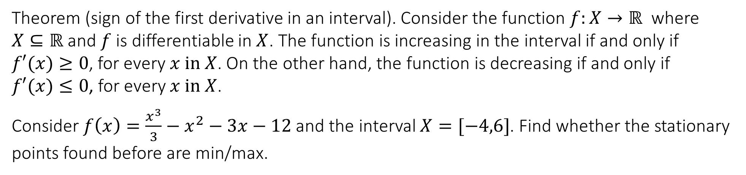
4.6 Higher order derivatives, stationary points and optimisation
Theorem (sign of the first derivative in an interval). Consider the function $f:X→ℝ$ where $X⊆ℝ$ and $f$ is differentiable in $X$. The function is increasing in the interval if and only if $f′(x)≥0$, for every $x in X$. On the other hand, the function is decreasing if and only if $f′(x)≤0$, for every $x in X$.
Consider $f\left(x\right)=\frac{x^{3}}{3}−x^{2}−3x−12$ and the interval $X=[−4,6]$. Find whether the stationary points found before are min/max.

Slide 23
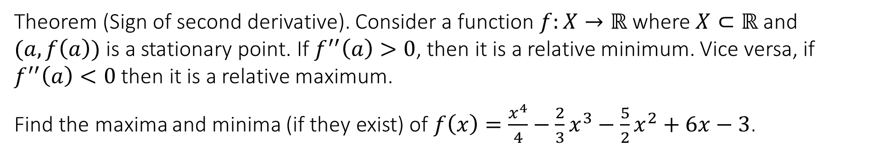
4.6 Higher order derivatives, stationary points and optimisation
Second derivative: convexity, concavity and points of inflection
Theorem (Sign of second derivative). Consider a function $f:X→ℝ$ where $X⊂ℝ$ and $(a,f\left(a\right))$ is a stationary point. If $f^{′′}\left(a\right)>0$, then it is a relative minimum. Vice versa, if $f^{′′}\left(a\right)<0$ then it is a relative maximum.
Find the maxima and minima (if they exist) of $f\left(x\right)=\frac{x^{4}}{4}−\frac{2}{3}x^{3}−\frac{5}{2}x^{2}+6x−3$.

Slide 24
4.6 Higher order derivatives, stationary points and optimisation
Find the maxima and minima (if they exist) of $f\left(x\right)=x^{2}\ln{x}$ in the interval $X=(0,1]$

Slide 25
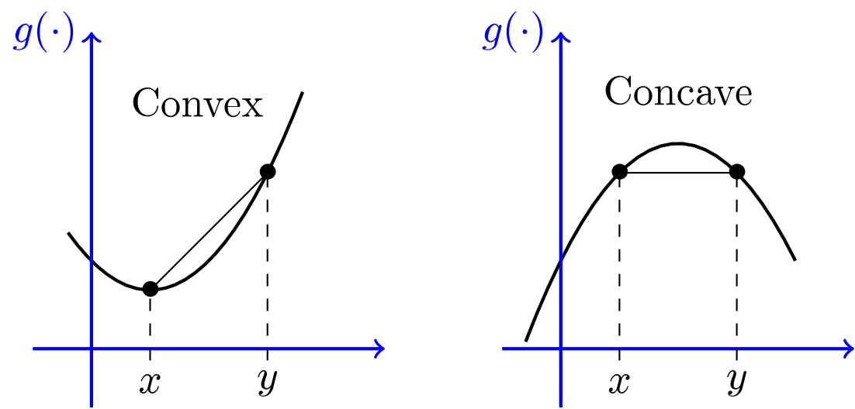
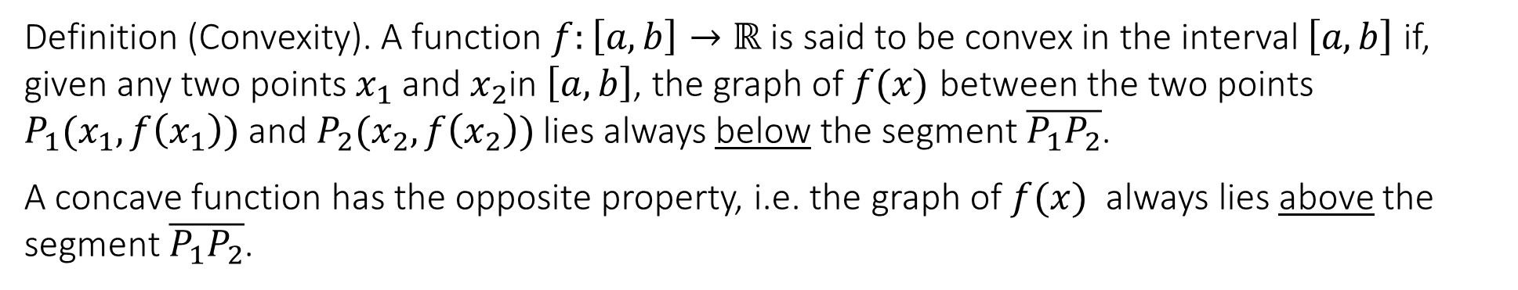
4.6 Higher order derivatives, stationary points and optimisation
Definition (Convexity). A function $f:\left[a,b\right]→ℝ$ is said to be convex in the interval $\left[a,b\right]$ if, given any two points $x_{1}$ and $x_{2}$in $\left[a,b\right]$, the graph of $f(x)$ between the two points $P_{1}(x_{1},f\left(x_{1}\right))$ and $P_{2}(x_{2}, f\left(x_{2}\right))$ lies always below the segment $\overline{P_{1}P_{2}}$.
A concave function has the opposite property, i.e. the graph of $f(x)$ always lies above the segment $\overline{P_{1}P_{2}}$.

Slide 26
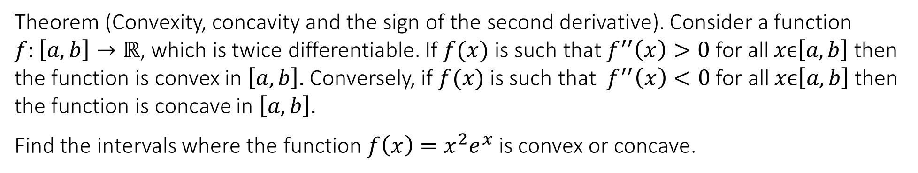
4.6 Higher order derivatives, stationary points and optimisation
Theorem (Convexity, concavity and the sign of the second derivative). Consider a function $f:\left[a,b\right]→ℝ$, which is twice differentiable. If $f(x)$ is such that $f^{′′}\left(x\right)>0$ for all $xϵ\left[a,b\right]$ then the function is convex in $\left[a,b\right].$ Conversely, if $f(x)$ is such that $f^{′′}\left(x\right)<0$ for all $xϵ\left[a,b\right]$ then the function is concave in $\left[a,b\right].$
Find the intervals where the function $f\left(x\right)=x^{2}e^{x}$ is convex or concave.

Slide 27
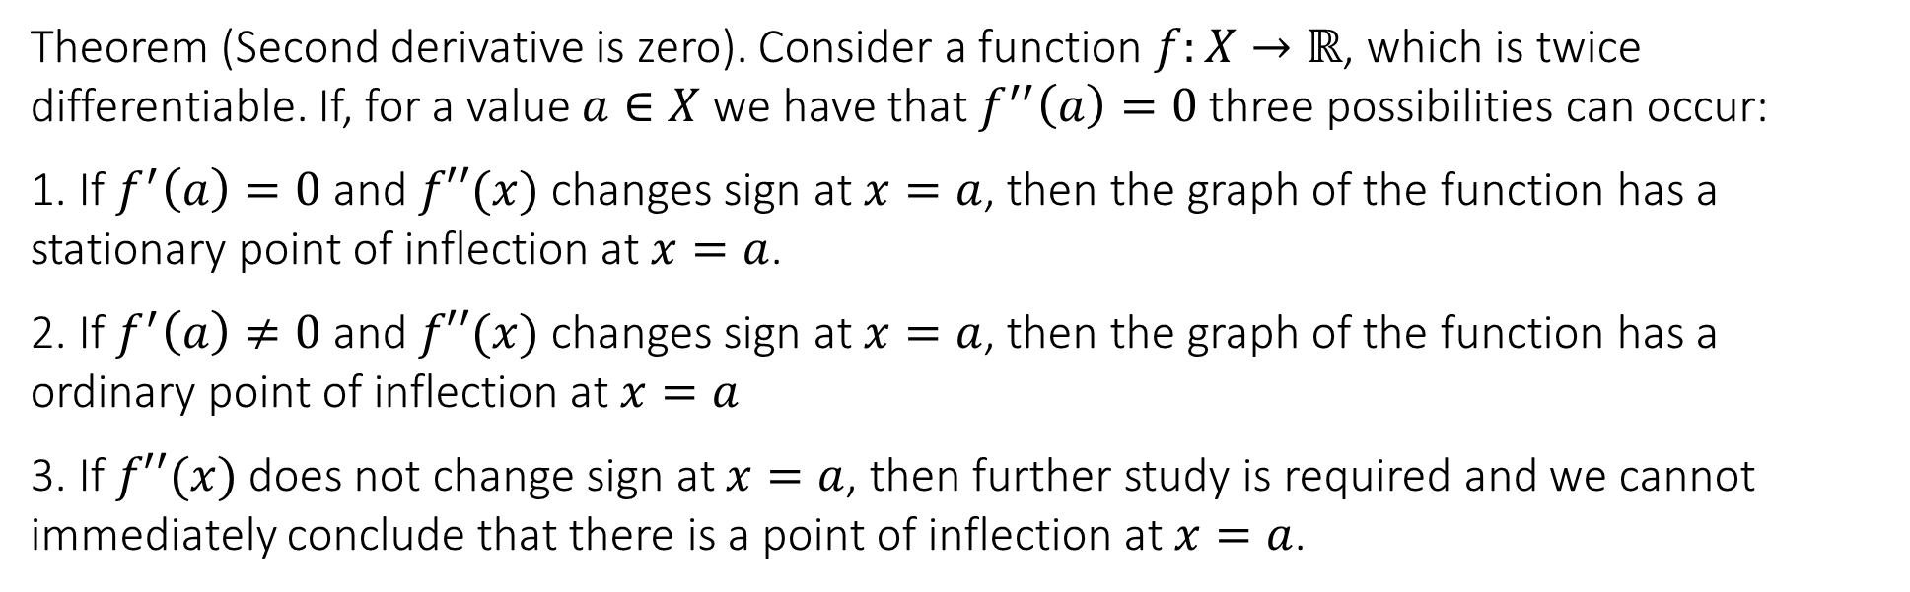
4.6 Higher order derivatives, stationary points and optimisation
Theorem (Second derivative is zero). Consider a function $f:X→ℝ$, which is twice differentiable. If, for a value $a∈X$ we have that $f^{′′}\left(a\right)=0$ three possibilities can occur:
1. If $f^{′}\left(a\right)=0$ and $f′′(x)$ changes sign at $x=a$, then the graph of the function has a stationary point of inflection at $x=a$.
2. If $f^{′}\left(a\right)≠0$ and $f′′(x)$ changes sign at $x=a$, then the graph of the function has a ordinary point of inflection at $x=a$
3. If $f′′(x)$ does not change sign at $x=a$, then further study is required and we cannot immediately conclude that there is a point of inflection at $x=a$.

Slide 28
4.6 Higher order derivatives, stationary points and optimisation
Determine the nature of the stationary points of the graph of the curve $f\left(x\right)=x^{3}−9x^{2}+24x+1$.

Slide 29
4.6 Higher order derivatives, stationary points and optimisation
What is the nature of the stationary point (0,0) of the function $f\left(x\right)=x^{4}−2x^{3}$.

Slide 30
4.6 Higher order derivatives, stationary points and optimisation
Is the point (0,0) a point of inflection in the function $f\left(x\right)=x^{6}−x^{4}$.

Slide 31
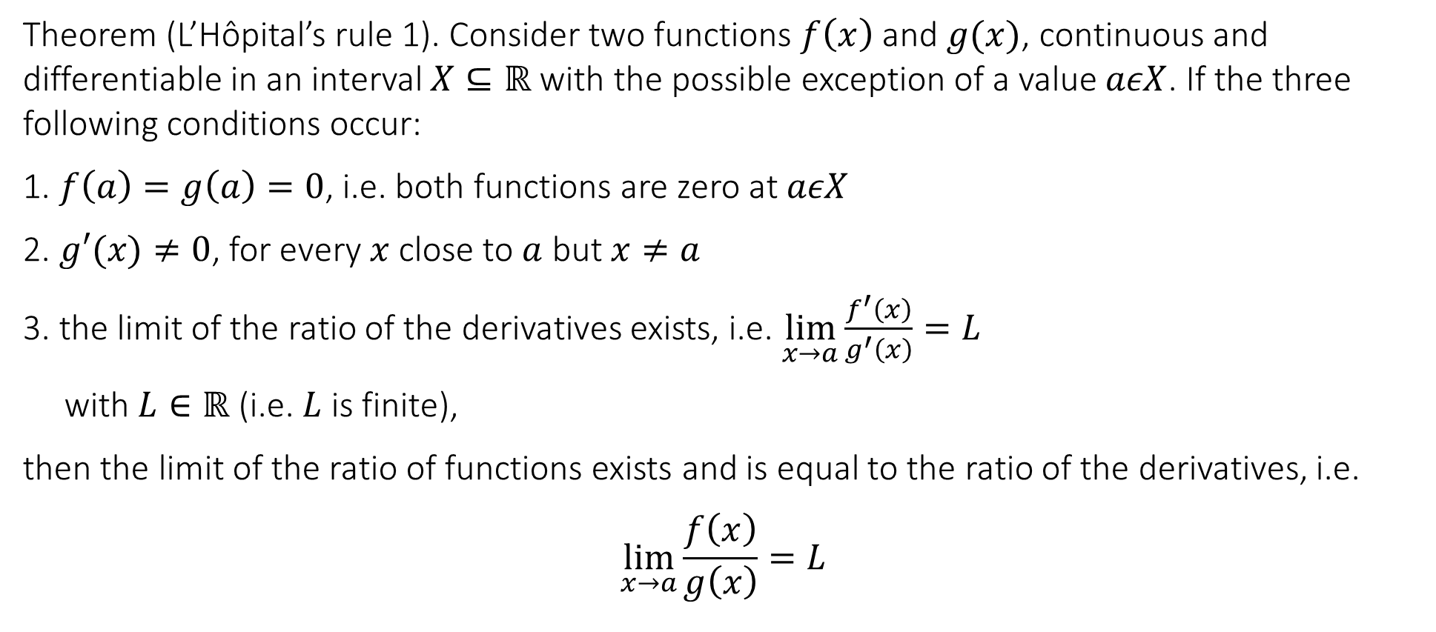
4.7 L’Hopital’s rule for indefinite forms $\left(\frac{0}{0}\right),\left(\frac{∞}{∞}\right),(∞∙0)$
Theorem (L’Hôpital’s rule 1). Consider two functions $f\left(x\right)$ and $g(x)$, continuous and differentiable in an interval $X⊆ℝ$ with the possible exception of a value $aεX$. If the three following conditions occur:
1. $f\left(a\right)=g\left(a\right)=0$, i.e. both functions are zero at $aεX$
2. $g′(x)≠0$, for every $x$ close to $a$ but $x≠a$
3. the limit of the ratio of the derivatives exists, i.e. $\lim_{x→a}{\frac{f^{′}\left(x\right)}{g^{′}\left(x\right)}=L}$
with $L∈ℝ$ (i.e. $L$ is finite),
then the limit of the ratio of functions exists and is equal to the ratio of the derivatives, i.e.
$$\lim_{x→a}{\frac{f\left(x\right)}{g\left(x\right)}=L}$$

Slide 32
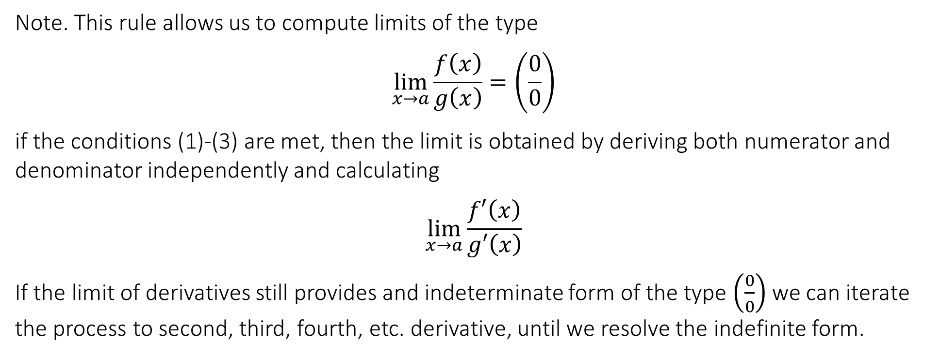
4.7 L’Hopital’s rule for indefinite forms $\left(\frac{0}{0}\right),\left(\frac{∞}{∞}\right),(∞∙0)$
Note. This rule allows us to compute limits of the type
$$\lim_{x→a}{\frac{f\left(x\right)}{g\left(x\right)}=\left(\frac{0}{0}\right)}$$
if the conditions (1)-(3) are met, then the limit is obtained by deriving both numerator and denominator independently and calculating
$$\lim_{x→a}{\frac{f′\left(x\right)}{g′\left(x\right)}}$$
If the limit of derivatives still provides and indeterminate form of the type $\left(\frac{0}{0}\right)$ we can iterate the process to second, third, fourth, etc. derivative, until we resolve the indefinite form.

Slide 33
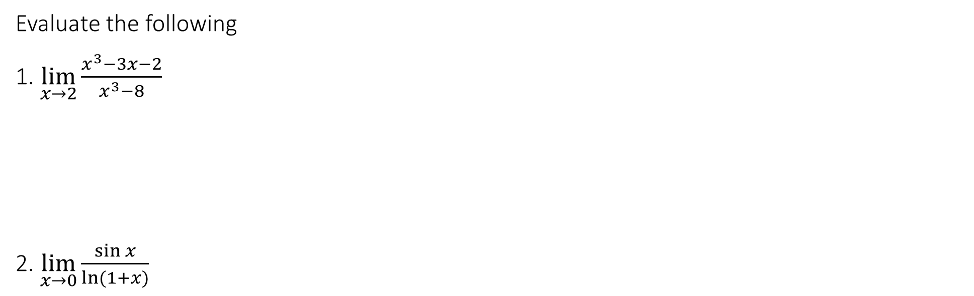
4.7 L’Hopital’s rule for indefinite forms $\left(\frac{0}{0}\right),\left(\frac{∞}{∞}\right),(∞∙0)$
Evaluate the following
1. $\lim_{x→2}{\frac{x^{3}−3x−2}{x^{3}−8}}$
2. $\lim_{x→0}{\frac{\sin{x}}{\ln{(1+x)}}}$

Slide 34

4.7 L’Hopital’s rule for indefinite forms $\left(\frac{0}{0}\right),\left(\frac{∞}{∞}\right),(∞∙0)$
Using L’Hôpital’s rule 1, verify that the following standard limits are correctly rediscovered.
SL.1 $\lim_{x→0}{\frac{\sin{x}}{x}}=1$
SL.2 $\lim_{x→0}{\frac{1−\cos{x}}{x^{2}}}=\frac{1}{2}$
SL.3 $\lim_{x→0}{\frac{e^{x}−1}{x}=1}$
SL.4 $\lim_{x→0}{\frac{\sqrt{1+x}−1}{x}=\frac{1}{2}}$
SL.5 $\lim_{x→0}{\frac{\ln{(1+x)}}{x}=1}$

Slide 35
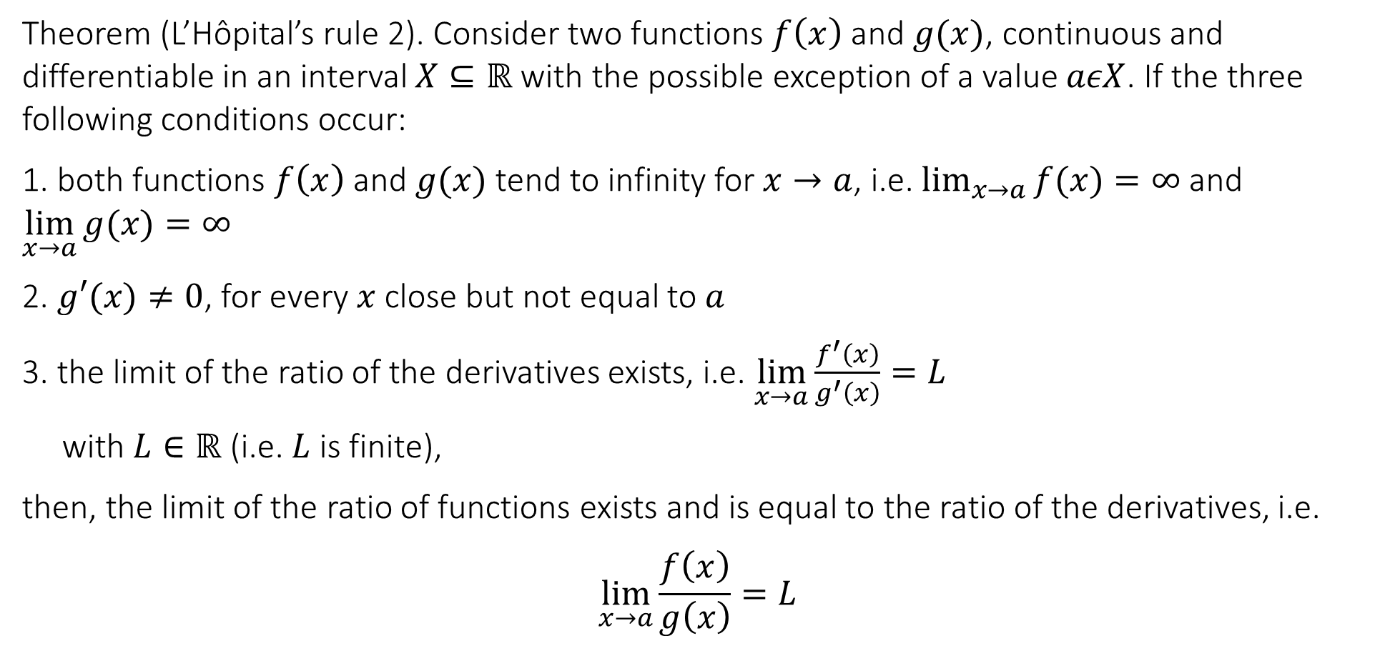
4.7 L’Hopital’s rule for indefinite forms $\left(\frac{0}{0}\right),\left(\frac{∞}{∞}\right),(∞∙0)$
Theorem (L’Hôpital’s rule 2). Consider two functions $f\left(x\right)$ and $g(x)$, continuous and differentiable in an interval $X⊆ℝ$ with the possible exception of a value $aεX$. If the three following conditions occur:
1. both functions $f\left(x\right)$ and $g(x)$ tend to infinity for $x→a$, i.e. $\lim_{x→a}{f(x)}=∞$ and $\lim_{x→a}{g(x)}=∞$
2. $g′(x)≠0$, for every $x$ close but not equal to $a$
3. the limit of the ratio of the derivatives exists, i.e. $\lim_{x→a}{\frac{f^{′}\left(x\right)}{g^{′}\left(x\right)}=L}$
with $L∈ℝ$ (i.e. $L$ is finite),
then, the limit of the ratio of functions exists and is equal to the ratio of the derivatives, i.e.
$$\lim_{x→a}{\frac{f\left(x\right)}{g\left(x\right)}=L}$$

Slide 36
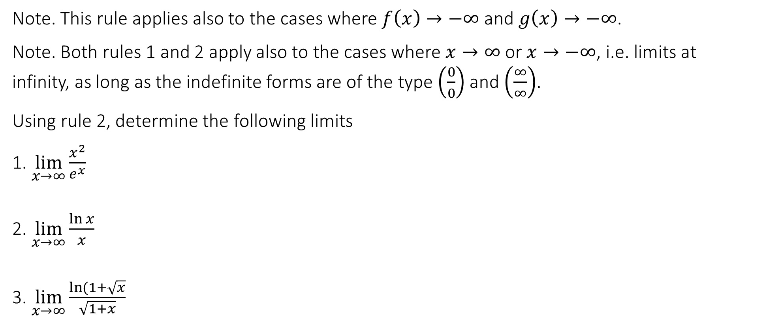
4.7 L’Hopital’s rule for indefinite forms $\left(\frac{0}{0}\right),\left(\frac{∞}{∞}\right),(∞∙0)$
Note. This rule applies also to the cases where $f\left(x\right)→−∞$ and $g\left(x\right)→−∞$.
Note. Both rules 1 and 2 apply also to the cases where $x→∞$ or $x→−∞$, i.e. limits at infinity, as long as the indefinite forms are of the type $\left(\frac{0}{0}\right)$ and $\left(\frac{∞}{∞}\right)$.
Using rule 2, determine the following limits
1. $\lim_{x→∞}{\frac{x^{2}}{e^{x}}}$
2. $\lim_{x→∞}{\frac{\ln{x}}{x}}$
3. $\lim_{x→∞}{\frac{\ln{(1+\sqrt{x}}}{\sqrt{1+x}}}$

Slide 37

4.7 L’Hopital’s rule for indefinite forms $\left(\frac{0}{0}\right),\left(\frac{∞}{∞}\right),(∞∙0)$
It is possible to re-express the indefinite form $(0∙∞)$ so that it morphs into one of the two indefinite forms for L’Hôpital’s rules.
Determine the following limits
1. $\lim_{x→∞}{x(\arctan{x}−\frac{π}{2})}$
2. $\lim_{x→0}{x}\ln{x}$

Slide 38
End of Lecture

